Slide 1

GS@HackTheDeep
Map the Collections

Slide 2

What are we trying to solve?

Slide 3
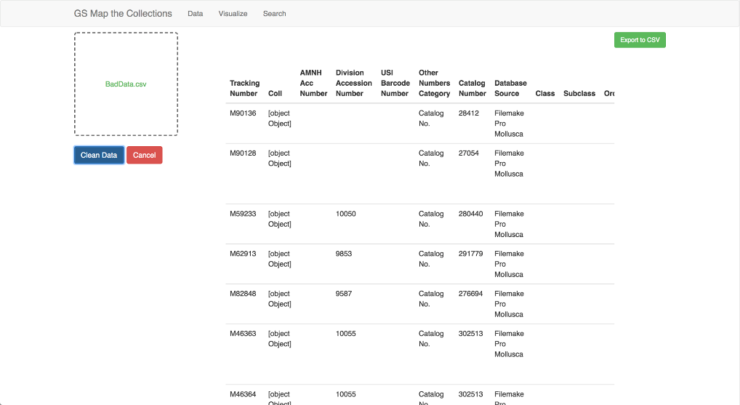
Clean and Transform Data

Slide 4
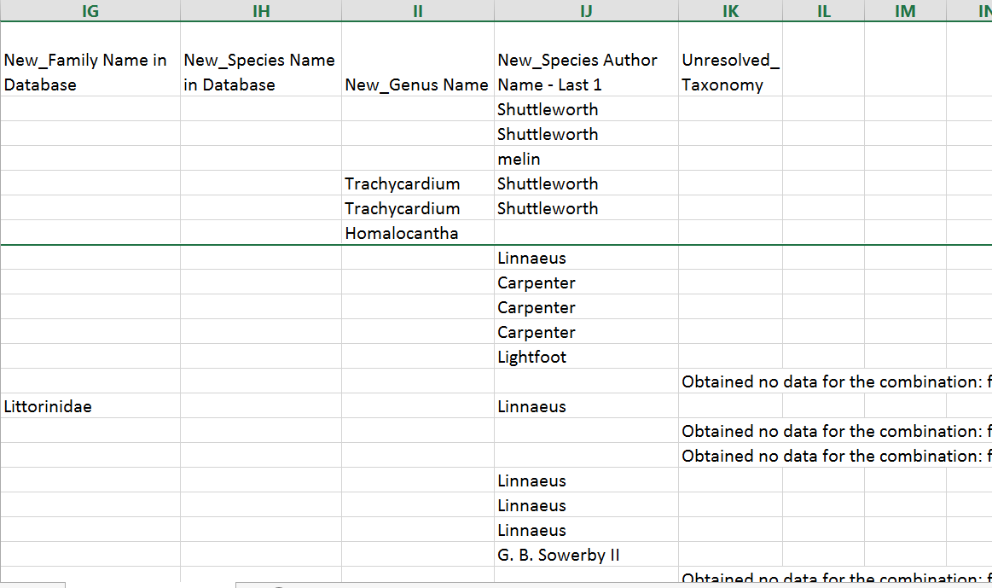
Clean Taxonomy Columns

Slide 5
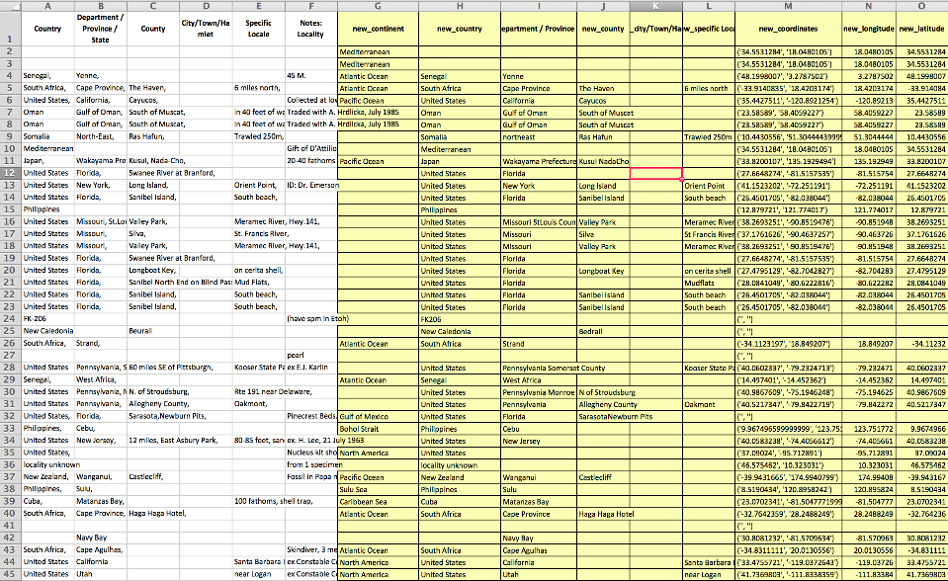
Clean Georeference Columns

Slide 6
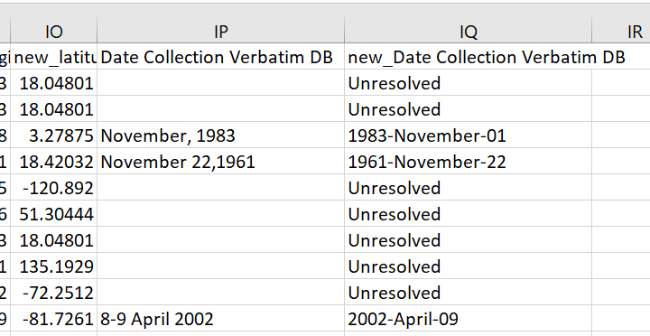
Clean Date Columns

Slide 7
You know, for search

Slide 8
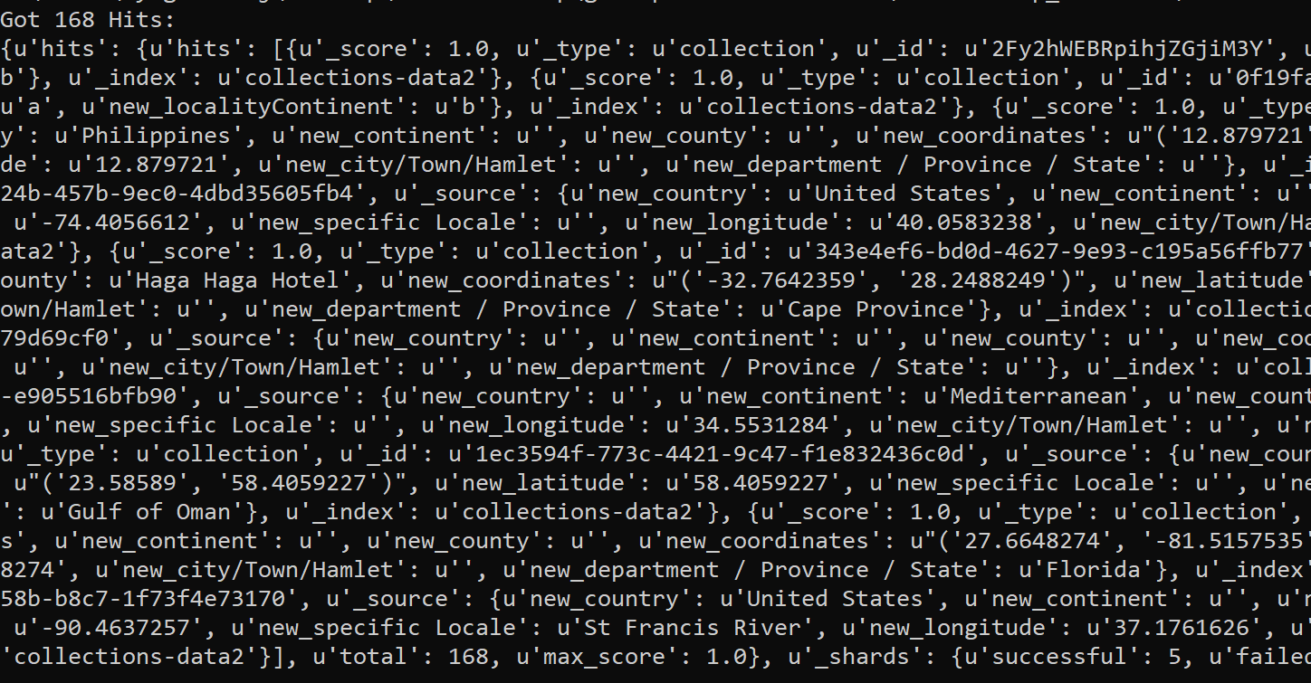
Store Transformed Data

Slide 9
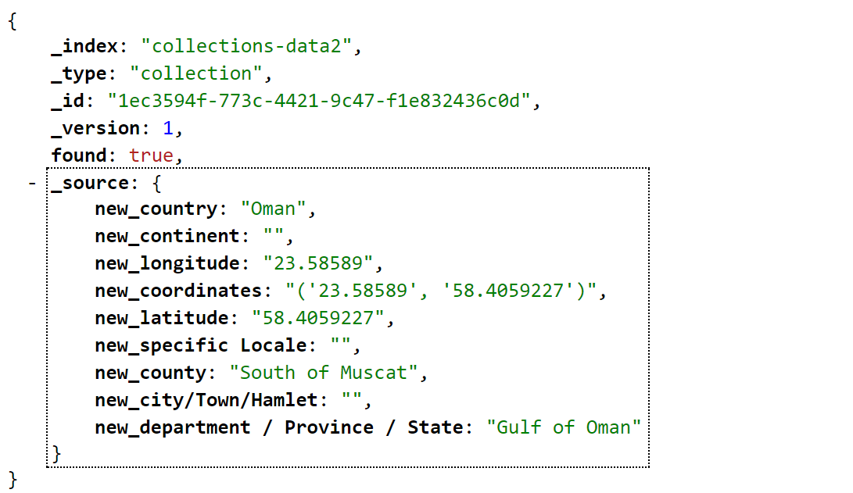
Sample Data in Elasticsearch

Slide 10
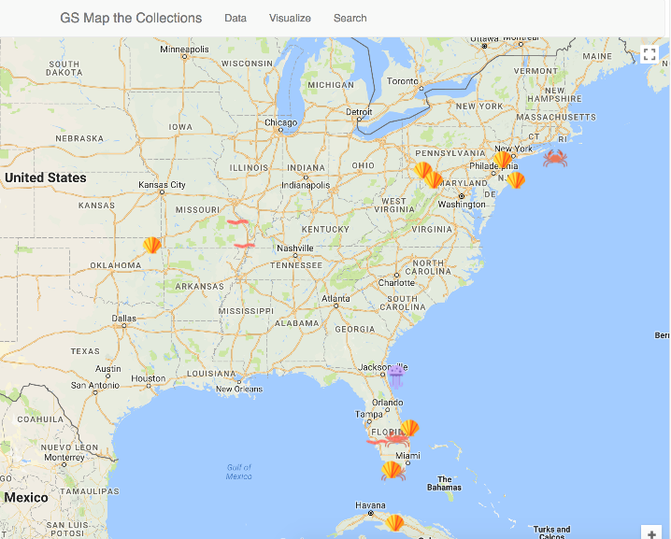
Visualize the Impact

Slide 11
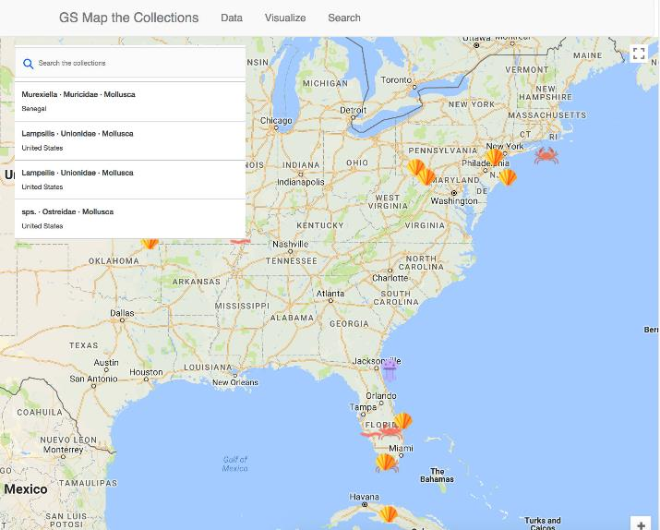
Search Functionality

Slide 12

Thank you

